Slide 1

Agenda
Project Topic – Main Questions
Data Sources, Exploration & Clean Up
Presentation of Questions & Results
Implications of Findings

Slide 2

Project Topic
Main Questions:
Is there a correlation between inflation and unemployment?
Is there a correlation between inflation and interest rates?
Summary of inflation/unemployment impacts on a regional/state basis?
Five-year analysis to determine trends prior, during and post Covid.

Slide 3




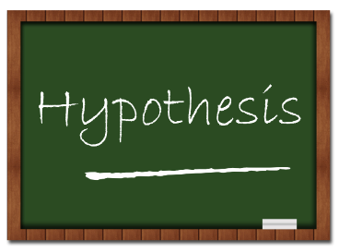

Data Sources, Exploration & Clean Up

Slide 4
Question One - Overview
Correlation between inflation and unemployment?
Data sources
Clean-up process
Jupyter Notebook
Data analysis
Results

Slide 5
Question One - Process
Jupyter notebook showing code used to clean data

Slide 6
Question One – Graph 1
Notes:
Add Visuals

Slide 7
Question One – Graph 2
Notes:
Add Visuals

Slide 8
Question Two - Overview
Correlation between inflation and interest rates?
Data sources
Clean-up process
Jupyter Notebook
Data analysis
Results

Slide 9
Question Two - Process
Jupyter notebook showing code used to clean data

Slide 10
Question Two – Graph 1

Slide 11
Question Two – Graph 2

Slide 12
Question Three - Overview
Inflation/unemployment impacts on a regional/state basis?
Data sources
Clean-up process
Jupyter Notebook
Data analysis
Results

Slide 13
Question Three - Process
Jupyter notebook showing code used to clean data

Slide 14
Question Three – Graph 1

Slide 15
Question Three – Graph 2

Slide 16



Five Year Analysis - Summary
Close out presentation with the implication of our findings and what they mean to us.

Slide 17
Content – Extra slide to use
Subtitle
Subtitle
Add text, images, art, and videos.
Add transitions, animations, and motion.
Save to OneDrive, to get to your presentations from your computer, tablet, or phone.
Add text, images, art, and videos.
Add transitions, animations, and motion.
Save to OneDrive, to get to your presentations from your computer, tablet, or phone.

Slide 18
Content 2
Subtitle
Subtitle
Subtitle
Add text, images, art, and videos.
Add transitions, animations, and motion.
Save to OneDrive, to get to your presentations from your computer, tablet, or phone.
Add text, images, art, and videos.
Add transitions, animations, and motion.
Save to OneDrive, to get to your presentations from your computer, tablet, or phone.
Add text, images, art, and videos.
Add transitions, animations, and motion.
Save to OneDrive, to get to your presentations from your computer, tablet, or phone.

Slide 19


THANK YOU

Slide 20
Table
 | Category 1 | Category 2 | Category 3 | Category 4
Item 1 | 4.5 | 2.3 | 1.7 | 5
Item 2 | 3.2 | 5.1 | 4.4 | 3
Item 3 | 2.1 | 1.7 | 2.5 | 2.8
Item 4 | 4.5 | 2.2 | 1.7 | 7

Slide 21

Project 1
Group 2
Zac Williams
Cole O’Neill
Joe Fisher
Justin Clawson
Selena Passeno

